Slide 1
Making this resource work for you
Prior to teaching this lesson, please refer to the ‘Unit Overview and Planning Document’.
Further guidance on planning Science Mastery lessons can be found in the detailed planning guidance document.
Refer to the ‘notes’ section on each slide for useful information, including suggested expositions, pedagogical content knowledge, suggested questions, answers and more. Consider using presenter mode so you can see this guidance throughout the lesson.
The introduction slides can be adapted to suit your teaching style and the needs of your class.
Before the lesson, adapt the fix-it slide to address any misconceptions identified in the previous lesson’s exit ticket.
Choose from the suggested activities to suit your class. The intention is not that you complete all of these, but that you select those which ones are most appropriate for your students. It may be appropriate to further adapt activities for your students.
These lessons are designed to occupy approximately 1 hour. To adapt for a shorter or longer lesson duration we advise you to adapt the activity section accordingly.
Please consider using the final slide to send feedback about this lesson or examples of PowerPoints that you have adapted to our design team. Your feedback is used to improve Science Mastery for all of our teachers and students. We appreciate all suggestions and comments.
Thank you for reading!
The Science Mastery Team

Slide 2

Taking it Further: Naturally Occurring Polymers
Answer the questions below.
Name the functional group found in carboxylic acids.
State what monomers require to be able to undergo condensation polymerisation.
Name the small molecule that is usually produced through condensation polymerisation.
Name the organelle that contains DNA in eukaryotic cells.
Describe the structure of DNA.
Carboxyl group
Two functional groups
Water
Nucleus
Repeating nucleotides made of a base (A,C,T,G), a phosphate and a sugar. Two strands of DNA are wrapped in a double helix.
Notes:
Big idea: Reactions rearrange matter
Foundation: Name the type of bonding found in polymers.
Stretch: Compare the processes of addition and condensation polymerisation.
Answers:
Foundation: Covalent
Stretch: Both produce a polymer from monomers but addition polymerisation only produces the polymer while condensation polymerisation also produces a small molecule, usually water. Condensation polymerisation requires monomers with two functional groups while addition polymerisation requires monomers with a C=C double bond.

Slide 3
Taking it Further: Naturally Occurring Polymers
Do Now:
Name the functional group found in carboxylic acids.
State what monomers require to be able to undergo condensation polymerisation.
Name the small molecule that is usually produced through condensation polymerisation.
Name the organelle that contains DNA in eukaryotic cells.
Describe the structure of DNA.
Drill:
Name the organelles that are found in both plant and animal cells.
Explain the difference between eukaryotic and prokaryotic cells.
Give an example of a prokaryotic cell.
Notes:
Drill answers:
Nucleus, cell membrane, cytoplasm, mitochondria
Eukaryotic cells contain membrane bound organelles, including the nucleus. Prokaryotic cells contain DNA in loops or a plasmid.
Bacteria, archaea

Slide 4
Taking it Further: Naturally Occurring Polymers
Read Now:
DNA (deoxyribonucleic acid) is one of the most important naturally occurring polymers in the world as it contains the instructions needed for all living organisms (and viruses) to grow, survive and reproduce. DNA consists of a double helix structure, with two strands of DNA. Each strand contains repeating nucleotide units, each of which contains a base, a sugar and a phosphate group. There are four different bases found in DNA and they are complementary pairs. Cytosine always binds to guanine and adenine always binds to thymine. These repeating nucleotide units are the monomers that make up the polymer DNA.
Explain why DNA is important.
Describe the structure of DNA
Identify the complementary base pairs in DNA.
Identify the monomers that make up the polymer DNA.
Notes:
Answers:
It contains the instructions for all living organisms to grow, survive and reproduce.
A double helix structure with two strands of DNA that contain nucleotides.
A and T, C and G
Nucleotides, made of a base, a sugar and a phosphate group

Slide 5

C5.1.15
04/10/2024
Taking it Further:
Naturally Occurring Polymers
C5.1.10 Taking it Further: Carboxylic Acids
C5.1.11 Taking it Further: Esters
C5.1.12 Polymers
C5.1.13 Taking it Further: Addition Polymerisation
C5.1.14 Taking it Further: Condensation Polymerisation
C5.1.15 Taking it Further: Naturally Occurring Polymers
C5.1.1 Prior Knowledge Review
C5.1.2 Crude Oil and Hydrocarbons
C5.1.3 Fractional Distillation
C5.1.4 Combustion of Hydrocarbons
C5.1.5 Cracking
C5.1.6 Taking it Further: Alkenes
C5.1.7 Taking it Further: Alcohols
C5.1.8 Taking it Further: Producing Ethanol by Fermentation
C5.1.9 Taking it Further: Producing Ethanol from Ethene
Notes:
Big Idea: Structure Determines Properties
In this final lesson, which is for separate science students, students will look at different naturally occurring polymers. This will include a review of the structure of DNA from B3.3. Higher tier students will also look in more detail at the functional groups of amino acids.
Suggested Hook:
One of the most important naturally occurring polymers is DNA. Why is DNA so important?

Slide 6

Following this lesson, students will be able to:
Identify different naturally occurring polymers and their monomers
Describe the structure of DNA
(HT) Describe how polypeptides are produced from amino acids
Key Words:
DNA
nucleotide
double helix
polypeptide
cellulose
Notes:
Guidance:
See unit overview document and planning guidance to see how these objectives are typically assessed at GCSE, including examples of what students should be able to do following this lesson.
Planning for different needs:
The learning objectives given on this slide are suggested based on the most common requirements for exams, however they can be adapted based on the needs of different classes.
For best practice, the unit preparation booklet should be used to determine the appropriate focus of lessons within the unit.
While it is not possible to explicitly split content into levelled grades, we recommend that lesson objectives can be classified as critical, core or stretch.
Critical: the content or skill is essential for all students to be able to progress.
Core: the content or skill is important for students to progress, but other opportunities may be available to revisit it.
Stretch: the content or skill may not be essential for all students but is important for students aiming for the highest grades.
Key skill: this is a crucial skill being developed in this unit as part of the skill mapping
C5.1.15 Lesson Objectives:
Critical: Identify different naturally occurring polymers and their monomers
Core: Describe the structure of DNA
Stretch: (HT) Describe how polypeptides are produced from amino acids

Slide 7
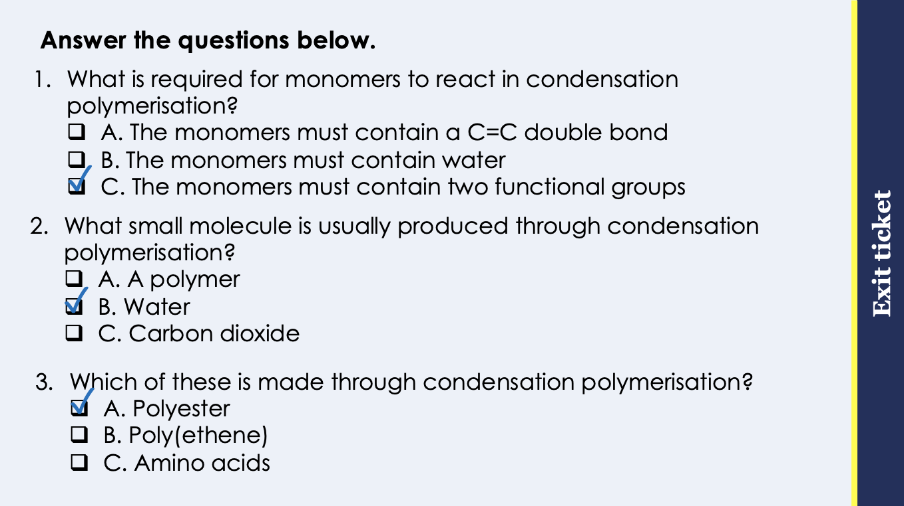
This is the fix-it portion of the lesson
The fix-it is an opportunity to respond to gaps in knowledge, especially those identified by the pre-unit quiz.
The teacher should customise this slide as needed, to facilitate
reteach, explanation, demonstration or modelling of ideas and concepts that students have not yet grasped or have misunderstood.
practise answering specific questions or of key skills.
redrafting or improving previous work.
Notes:
Purpose: to spend time on any gaps identified in previous learning from previous exit ticket.
Guidance from previous exit ticket:
Q1. Answer: C
If students answer A, they have confused the monomers that react in addition and condensation polymerisation. If students answer B, they have confused the requirements of the reactant monomers with the product. To fix-it, review the differences in the monomers for addition and condensation polymerisation.
Q2. Answer: B
If students answer A, they have incorrectly suggested that a polymer is a small molecule, which is a common error in exam answers for this question. If students answer C, they have not identified that water is the most commonly made small molecule. To fix it, review what happens during condensation polymerisation and show how water is produced from the functional groups.
Q3. Answer: A
If students answer B, they are not clear on the difference between addition and condensation polymerisation. If students answer C, they have not recognised that amino acids are the monomers. To fix it, review an example of a condensation polymerisation reaction.

Slide 8
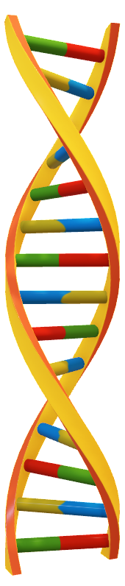
Naturally Occurring Polymers
Some polymers can be man-made, but many are naturally occurring.
One of the most important naturally occurring polymers is DNA.
DNA contains the genetic instructions for development and functioning of living organisms and viruses.
Most DNA molecules are two polymer chains held together in a double helix.
DNA is a polymer made from nucleotide monomers.
Other naturally occurring polymers and their monomers are:
Polymer | Monomer
Starch | Glucose
Cellulose | (Beta) Glucose
Protein | Amino acids
Notes:
Suggested exposition:
Over the last couple of lessons, we have looked at different ways of making polymers.
What is a polymer?
A long chain molecule made of repeating units.
One of the polymers we looked at in the last lesson was polyester, which is formed through condensation polymerisation. There are some man-made polyesters, such as those made for clothing, but some can also be naturally-occurring.
Over the course of your science learning, we have also met other naturally occurring polymers. One of the most important of these is DNA. DNA (deoxyribonucleic acid) is a large molecule essential for life, as it encodes genetic instructions for the development and functioning of living organisms and viruses. Most DNA molecules are two polymer chains, made from four different monomers called nucleotides, in the form of a double helix.
Other naturally occurring polymers important for life include proteins, starch and cellulose.
Now let’s look at the structure of DNA in more detail.

Slide 9
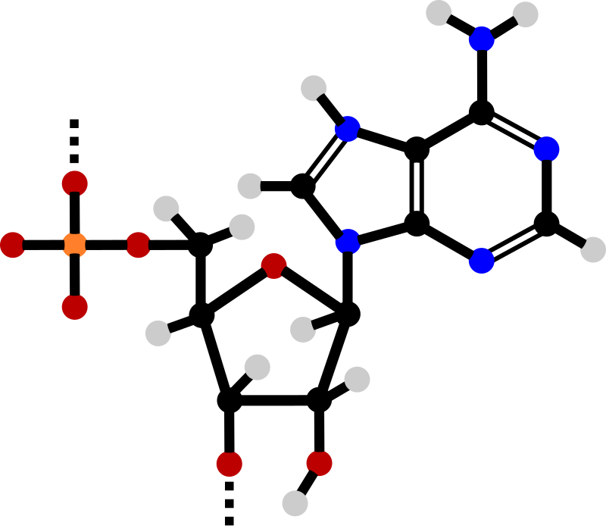
The structure of DNA
DNA is a polymer made up from repeating units called nucleotides
Nucleotides are made up of three parts – phosphate group, sugar and a base
The phosphate and sugar make the backbone of the DNA
There are 4 different types of base (A, T, C and G)
Hydrogen bonds between the bases hold the two strands together.
Phosphate group
Base
Pentose sugar
A
T
C
G
Notes:
This slide and the following slide are a review of the structure of DNA from B3.3
Suggested exposition (it would be beneficial to have a model of DNA to use to exemplify the structure – request from your technician):
We know that DNA is a polymer, made from many monomers. These monomers are called nucleotides. The diagram here shows the structure of a nucleotide, but we don’t need to be able to draw it in this much detail. Let’s simplify it.
Each nucleotide is made of three parts, a phosphate group, a sugar and a base. The phosphate and sugar make the backbone of the DNA (you could choose to dual code this to help students visualize the phosphate and pentose sugar making up the sugar-phosphate backbone). The backbone provides stability to the DNA molecule and protects the bases inside. The sequence of bases determines the genetic code.
There are four different types of bases: Adenine, Thymine, Cytosine and Guanine. We just need to know the letters. A always pairs with T and C always pairs with G, as their shapes are complementary (Where have we heard the term ‘complementary’ before? Answer: When looking at the lock and key theory of enzyme action).
Stretch: there are two Hydrogen bonds between A and T and 3 Hydrogen bonds between C and G. Overall this produces a large number of bonds throughout the length of DNA and this creates stability in the DNA structure. Each individual H bond is fairly weak but added together the effect becomes very strong.
Stretch: The possible reasons behind complementary base pairing could be discussed. Including fidelity of message during replication, stability of structure.

Slide 10
Calculating the composition of DNA
A
T
Adenine (A) is complementary to Thymine (T), and Cytosine (C) is complementary to Guanine (G). They are in a 1:1 ratio.
C
G
We can use this information to calculate the composition of DNA.
Example:
33% of nucleotides in DNA molecule include the base Thymine (T):
What percentage of the nucleotides contain Adenine?
What percentage of the nucleotides contain Cytosine?
What is the unit ratio of Adenine : Cytosine?
33%
17%
1.94 : 1
Notes:
Suggested exposition:
If we know that base pairs are complementary, we can use this information to calculate the composition of DNA.

Slide 11
Amino acids and polypeptides
Higher Tier only
Amino acids contain two different functional groups in a molecule.
This means they can react to form polypeptides through condensation polymerisation.
Glycine
H
Condensation polymerisation
H
O
N
C
→
C
HN
CH₂
CO
H
O H
n
H
+
n H₂O
Notes:
Suggested exposition:
Proteins are also important naturally occurring polymers. They are made from amino acids.
Amino acids have two different functional groups in a molecule. This means that they can react by condensation polymerisation to produce polypeptides. A polypeptide is a chain of many amino acids and a protein contains one or more polypeptides.
Different amino acids can be combined in the same chain to produce proteins.
Let’s look at an example.
Glycine is the simplest of the amino acids.
Animate glycine.
It has two different functional groups in the molecule. That means it can polymerise with many other glycine molecules to make a polypeptide.
Animate polypeptide. This shows a section of the polypeptide formed.
What else will be formed in this reaction?
Water.
Unlike in condensation polymerisation reactions where there are two different monomers, here there is only one type of monomer. This means that instead of there being two water molecules for every monomer (one formed from the function group at each end), there is just one. So we can write this as nH₂O.

Slide 12




Which statements do you agree with?
Amino acids have the same functional group on either side of the molecule
Amino acids have two different functional groups in the molecule
Polypeptides can be formed from amino acids through addition polymerisation
Polypeptides can be formed from amino acids through condensation polymerisation
Notes:
Suggested points:
Blue: correct
Yellow: incorrect
Green: incorrect
Pink: correct
Suggested guidance:
Talk tasks can be used in a variety of ways to suit the particular needs of the students you are teaching. Through exchanging views with others, students develop their understanding of the science beyond what could be achieved individually.
Science classrooms that successfully integrate talk have the following features:
Science talk is a regular feature of lessons and is woven into classroom activities.
Students are paired or grouped strategically by the teacher to ensure productive interaction. This might take into consideration the students’ proficiency of the English language, how encouraging they might be to peers and their attainment in the topic. It’s a good idea to consider these pairings in the class seating plan.
Students are encouraged and supported to talk, but are not forced to talk.
The teacher should take on the role of a facilitator, engaging with conversations where necessary and encouraging or steering the conversation where needed.
Students are encouraged to use the language they have to express their ideas (e.g., everyday language, imperfect English, native language), but also to incorporate science specific terminology where this is more accurate or has been taught.
6. Scientifically inaccurate ideas are not dismissed by the partner or teacher; open discussion and further investigation are relied on to help students construct ideas that support them to progress in their scientific understanding.
7. Guidelines for behaviour during talk tasks are explicit and frequently reviewed. Rules for students might be:
Listen carefully to your partner
Take turns talking.
Speak one at a time, without interrupting.
Politely agree or disagree and explain why.
Politely point out if your partner has used a scientific word incorrectly, if they have explained the science incorrectly, or if there is a more accurate way to describe something.
If confused, ask questions.
Stay focused on the discussion topic.
Respond to one another.

Slide 13
With your partner, draw and describe the structure of DNA.
Describe the overall structure of DNA
Draw and label the structure of one nucleotide
Consider how these nucleotides join together to form a single polymer strand
Stretch: The two DNA strands are antiparallel. Suggest what this means.
P
Phosphate
Sugar
Base
Notes:
Suggested guidance:
Talk tasks can be used in a variety of ways to suit the particular needs of the students you are teaching. Through exchanging views with others, students develop their understanding of the science beyond what could be achieved individually.
Science classrooms that successfully integrate talk have the following features:
Science talk is a regular feature of lessons and is woven into classroom activities.
Students are paired or grouped strategically by the teacher to ensure productive interaction. This might take into consideration the students’ proficiency of the English language, how encouraging they might be to peers and their attainment in the topic. It’s a good idea to consider these pairings in the class seating plan.
Students are encouraged and supported to talk, but are not forced to talk.
The teacher should take on the role of a facilitator, engaging with conversations where necessary and encouraging or steering the conversation where needed.
Students are encouraged to use the language they have to express their ideas (e.g., everyday language, imperfect English, native language), but also to incorporate science specific terminology where this is more accurate or has been taught.
6. Scientifically inaccurate ideas are not dismissed by the partner or teacher; open discussion and further investigation are relied on to help students construct ideas that support them to progress in their scientific understanding.
7. Guidelines for behaviour during talk tasks are explicit and frequently reviewed. Rules for students might be:
Listen carefully to your partner
Take turns talking.
Speak one at a time, without interrupting.
Politely agree or disagree and explain why.
Politely point out if your partner has used a scientific word incorrectly, if they have explained the science incorrectly, or if there is a more accurate way to describe something.
If confused, ask questions.
Stay focused on the discussion topic.
Respond to one another.
Suggested guidance: Students to work in pairs to work through the tasks using MWBs or A3 paper.
Model answers on next slide.

Slide 14
Describe the overall structure of DNA
DNA is a polymer made of many nucleotides. The nucleotides are arranged in two strands which form a double helix. Each nucleotide is made of a phosphate group, a sugar and a base. There are four bases (A,T,C,G). A is complementary to T, and C is complementary to G.
Draw and label the structure of one nucleotide
Consider how these nucleotides join together to form a single polymer strand. Describe the bonding that holds together the two polymer strands.
Bonds form between the sugar molecule of one nucleotide and the phosphate group of the next to form a polymer strand. Hydrogen bonds between complementary bases (A and T, C and G) hold together the two strands as a double helix.
Phosphate
P
Sugar
Base
Notes:
Purpose: to provide students with time to develop their understanding of the structure of DNA.
Suggested guidance: Students could use this to peer-mark the work of another group, or it could be used to review the activity as a class.
Stretch: The two DNA strands are antiparallel. Suggest what this means.
Answer: The two strands run side by side to each other, but the nucleotides face in the opposite direction

Slide 15
Answer the following questions:
Identify the three parts of a nucleotide:
A. Glucose, phosphate and adenine
B. Sugar, phosphorus and base
C. Sugar, phosphate and base
2. Select the correct complementary base pairs:
A. A with T and C with G
B. A with G and T with C
C. A with C and T with G
3. The percentage of the base thymine (T) in a human’s DNA was found to be 28%. Calculate the percentage of human DNA that is adenine (A).
14%
28%
22%
Notes:
1C
2A
3B

Slide 16
Drill
Describe the function of DNA.
Describe the structure of DNA.
Describe what makes up a nucleotide.
State the complementary base pairs.
Give two other naturally occurring polymers.
(HT) State whether the functional groups found in amino acid molecules are the same or different.
(HT) Name the type of reaction that produces a polypeptide from amino acids.
(HT) Name the other product of this reaction.
Notes:
Purpose: This is a knowledge drill. The purpose of this is to check that the critical knowledge is secure before pupils move onto independent practice.
Suggested guidance: There are a range of ways this could be done depending on time and ability range of the class:
Mini whiteboards
As full sentences in exercise books
As short answers in exercise books
In the pupil workbook
As pair talk
As cold call

Slide 17
Drill answers
It contains the genetic instructions for development and functioning of living organisms and viruses.
Two polymer chains made up of nucleotides held in a double helix.
A base, a phosphate and a sugar
A and T, C and G
Starch, cellulose, proteins
The functional groups are different
Condensation polymerisation
Water
Notes:
Purpose: This is a knowledge drill. The purpose of this is to check that the critical knowledge is secure before pupils move onto independent practice.
Suggested guidance: There are a range of ways this could be done depending on time and ability range of the class:
Mini whiteboards
As full sentences in exercise books
As short answers in exercise books
In the pupil workbook
As pair talk
As cold call

Slide 18

I: Explain: to use scientific understanding to make something clear or state the reason for something happening
Example question:
To ‘explain’ your answer should:
Begin with a scientific statement.
Use ‘this means that’, ‘because’ or ‘so’ to link your statement to the question.
Explain why DNA is described as a polymer.
Model answer:
DNA consists of two strands held in a double helix
Each strand contains repeating nucleotide units
This means that DNA is a polymer because it consists of repeating subunits/monomers
Notes:
Purpose: The I-We-You section aims to support pupils to build skills that they most commonly need when answering questions associated with this knowledge in the assessment. This section is also used to interleave other content we expect pupils to know at this stage of their education in order that they build a big picture of the science they are learning.
For the ‘I’ activity, the teacher should model how to answer the question. They can do this by narrating their thinking process aloud, and making links to learning earlier in the lesson explicit.
For the ‘we’ activity, the teacher and students work though a similar example together, in order to prepare students to be able to answer a similar question independently.
Opportunities for the ‘you’ activity – independent practise – occur in the activity portion of the lesson once the student is secure enough to process independently.
This slide models the process of answering an explain question.
Firstly, students are presented with a generic explain question, along with a model answer. Students are also given some simple guidance to follow for producing their own describe answer.
The generic question and answer should be used by the teacher to remind students of
the key features of a great answer
how to structure their answer
why the model answer is a good example
Following this, students will be required to apply this process to answer their own explain question, which will appear in place of the generic questions. This explain question will be specific to the topic students are learning about in the lesson. Give students time to write their own answer to this, ensuring that they use the guidance provided. To further scaffold this task for students, it may be appropriate to:
pair students up to write an answer together
list for students the key words you would like them to include in the answer
provide a writing frame or ‘points to include’ for students
A model answer for this question will appear. Teachers should review the model answer with students by referencing the guidance in the green box. For example ‘we can see item 1 in the guidance is to begin with a scientific statement. Notice in the model answer here we have done just that’. Or ‘item 2 in the guidance here says that we should use a linking statement in the answer. Has this been achieved in the model answer? Where can we see this?’.

Slide 19
We: Explain: to use scientific understanding to make something clear or state the reason for something happening
Example question:
To ‘explain’ your answer should:
Begin with a scientific statement.
Use ‘this means that’, ‘because’ or ‘so’ to link your statement to the question.
Explain why polypeptides are described as polymers.
Model answer:
Polypeptides consists of amino acids in a chain
This means that polypeptides are polymers because they consist of repeating subunits/monomers
Notes:
Purpose: The I-We-You section aims to support pupils to build skills that they most commonly need when answering questions associated with this knowledge in the assessment. This section is also used to interleave other content we expect pupils to know at this stage of their education in order that they build a big picture of the science they are learning.
For the ‘I’ activity, the teacher should model how to answer the question. They can do this by narrating their thinking process aloud, and making links to learning earlier in the lesson explicit.
For the ‘we’ activity, the teacher and students work though a similar example together, in order to prepare students to be able to answer a similar question independently.
Opportunities for the ‘you’ activity – independent practise – occur in the activity portion of the lesson once the student is secure enough to process independently.
This slide models the process of answering an explain question.
Firstly, students are presented with a generic explain question, along with a model answer. Students are also given some simple guidance to follow for producing their own describe answer.
The generic question and answer should be used by the teacher to remind students of
the key features of a great answer
how to structure their answer
why the model answer is a good example
Following this, students will be required to apply this process to answer their own explain question, which will appear in place of the generic questions. This explain question will be specific to the topic students are learning about in the lesson. Give students time to write their own answer to this, ensuring that they use the guidance provided. To further scaffold this task for students, it may be appropriate to:
pair students up to write an answer together
list for students the key words you would like them to include in the answer
provide a writing frame or ‘points to include’ for students
A model answer for this question will appear. Teachers should review the model answer with students by referencing the guidance in the green box. For example ‘we can see item 1 in the guidance is to begin with a scientific statement. Notice in the model answer here we have done just that’. Or ‘item 2 in the guidance here says that we should use a linking statement in the answer. Has this been achieved in the model answer? Where can we see this?’.

Slide 20
You: Explain: to use scientific understanding to make something clear or state the reason for something happening
Example question:
To ‘explain’ your answer should:
Begin with a scientific statement.
Use ‘this means that’, ‘because’ or ‘so’ to link your statement to the question.
Explain why starch is described as a polymer.
Model answer:
Starch consists of glucose molecules in a chain
This means that starch is a polymers because is consists of repeating subunits/monomers
Notes:
Purpose: The I-We-You section aims to support pupils to build skills that they most commonly need when answering questions associated with this knowledge in the assessment. This section is also used to interleave other content we expect pupils to know at this stage of their education in order that they build a big picture of the science they are learning.
For the ‘I’ activity, the teacher should model how to answer the question. They can do this by narrating their thinking process aloud, and making links to learning earlier in the lesson explicit.
For the ‘we’ activity, the teacher and students work though a similar example together, in order to prepare students to be able to answer a similar question independently.
Opportunities for the ‘you’ activity – independent practise – occur in the activity portion of the lesson once the student is secure enough to process independently.
This slide models the process of answering an explain question.
Firstly, students are presented with a generic explain question, along with a model answer. Students are also given some simple guidance to follow for producing their own describe answer.
The generic question and answer should be used by the teacher to remind students of
the key features of a great answer
how to structure their answer
why the model answer is a good example
Following this, students will be required to apply this process to answer their own explain question, which will appear in place of the generic questions. This explain question will be specific to the topic students are learning about in the lesson. Give students time to write their own answer to this, ensuring that they use the guidance provided. To further scaffold this task for students, it may be appropriate to:
pair students up to write an answer together
list for students the key words you would like them to include in the answer
provide a writing frame or ‘points to include’ for students
A model answer for this question will appear. Teachers should review the model answer with students by referencing the guidance in the green box. For example ‘we can see item 1 in the guidance is to begin with a scientific statement. Notice in the model answer here we have done just that’. Or ‘item 2 in the guidance here says that we should use a linking statement in the answer. Has this been achieved in the model answer? Where can we see this?’.

Slide 21
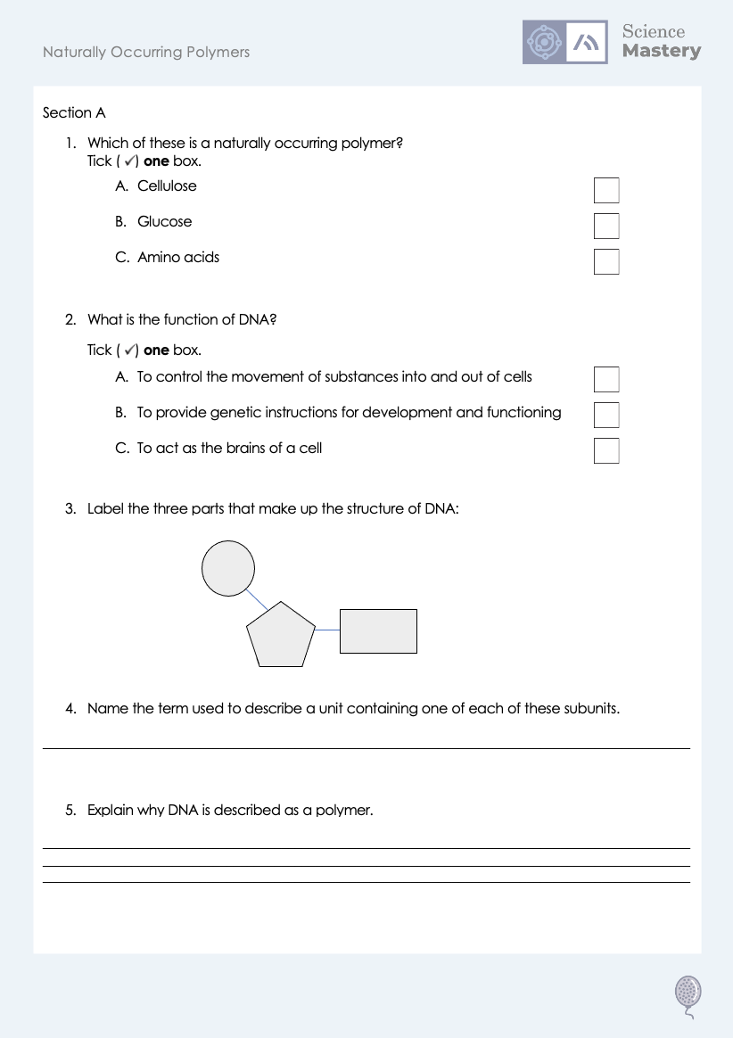
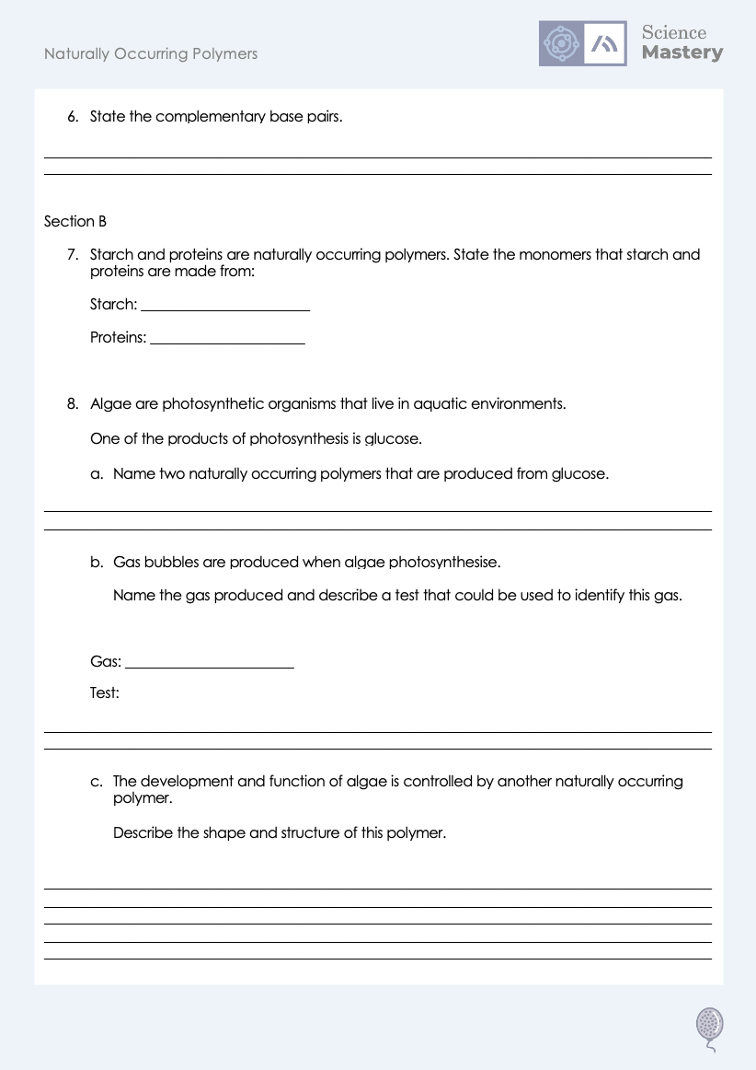
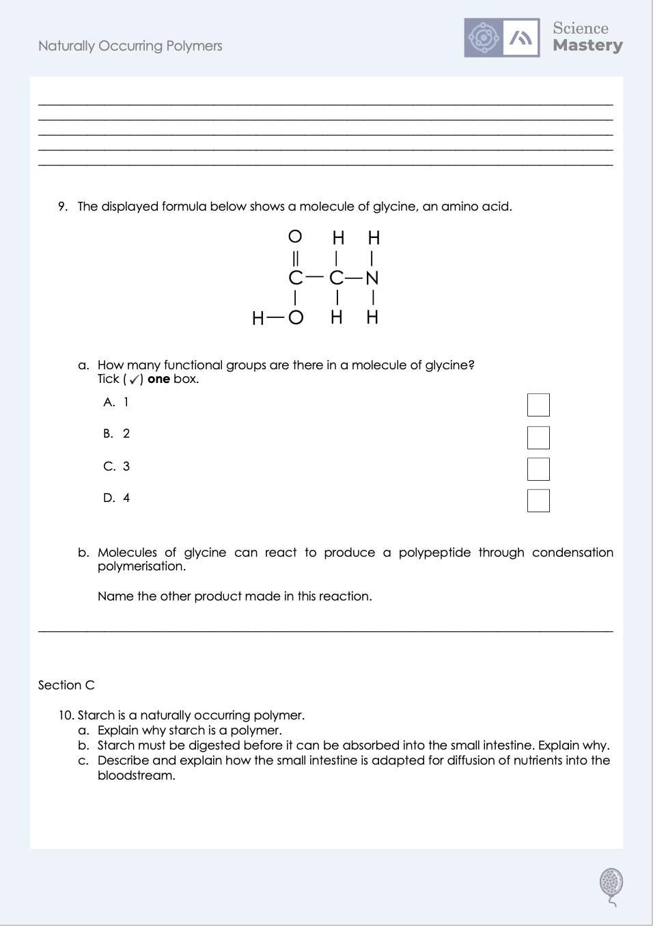
Worksheet

Slide 22
Answers
1. A - Cellulose
2. B - To provide genetic instructions for development and functioning
3.
Phosphate
Base
Sugar
4. Nucleotide
5. It is made up of repeating units (nucleotides).
6. Adenine and thymine, cytosine and guanine

Slide 23
Answers
7.
Starch: glucose
Proteins: amino acids
8a. Starch and cellulose
8b.
Gas: oxygen
Test: relights a glowing splint
8c. DNA is a polymer made up of repeating units called nucleotides. Each nucleotide contains a phosphate group, a sugar and a base. The phosphate and sugar make up the backbone on the DNA. There are four different bases, which are in complementary pairs, and these complementary pairs link the two strands of DNA together to form the double helix.

Slide 24
Answers
9a. 2
9b. Water
10a. It is made up of repeating units of glucose.
10b. Starch is a large and insoluble molecule that cannot pass through the semipermeable membrane of cells in the small intestine.
10c.
It is very long in length, which increases the time for absorption
It has villi and microvilli, which increase the surface are for more absorption
The villi are very thin, so there is a short path for diffusion
There is a good blood supply, so the concentration gradient can be maintained for diffusion

Slide 25
Answer the questions below.
What are the monomers that make up DNA?
A. Nucleotides
B. Amino acids
C. Base pairs
✓
Which of these is a naturally occurring polymer?
A. Poly(ethene)
B. Cellulose
C. Glucose
✓
How can polypeptides be produced from amino acids?
A. Amino acids contain two different functional groups so can undergo condensation polymerisation
B. Amino acids contain two different functional groups so can undergo addition polymerisation
C. Amino acids contain two of the same functional group so can undergo condensation polymerisation
✓
Notes:
Q1. Answer: A
If students answer B, they have confused the monomers for proteins/polypeptides. If students answer C, they have not understood that the whole nucleotide is the repeating unit and that base pairs are found on opposite strands. To fix-it, review the structure of DNA.
Q2. Answer: B
If students answer A, they have not understood where ethene and therefore polyethene comes from. If students answer C, they have confused monomers and polymers. To fix it, review the examples of naturally occurring polymers and explain the difference between naturally-occurring and man-made.
Q3. Answer: A
If students answer B, they have recognised the correct description of the functional groups but not the type of polymerisation. If students answer C, they have recognised the correct type of polymerisation but not the correct description of the functional groups. To fix it, review how polypeptides are made from amino acids through condensation polymerisation.

Slide 26
Lesson C5.1.15
What was good about this lesson? | What can we do to improve this lesson?
Send us your feedback by clicking this link
or by emailing sciencemastery@arkonline.org
Thank you!

